Slide 1
Discussion Unit: Why DSE Analytics
Understand the Why of Analytics
Four Primary Functional Areas to DSE
History of Apache Spark (history of Apache Hadoop)
5 Functional Areas to (DSE Analytics)
Business Value of DSE Analytics, Use Cases
(Introduction to Analytics)
Notes:
The goal of this Discussion Unit is to gain an understanding of DSE Analytics:
Understand the Why of Analytics
Four Primary Functional Areas to DSE
History of Apache Spark (history of Apache Hadoop)
5 Functional Areas to (DSE Analytics)
Business Value, Use Cases

Slide 2
Discussion Lab:
DSE Analytics; Hadoop versus Spark, languages and functions
Matching pairs – Match the attributes on the right with the areas on the left
Notes:
On the next page we enter a Discussion Lab.

Slide 3


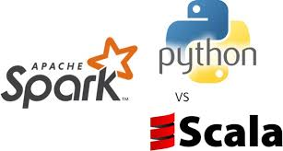
DSE Analytics: Hadoop versus Spark
Distributed Filesystem (HDFS)
Computing engine, not a storage system
Composable API based on functional programming
Operates on Key/Value (K/V) pairs
K/V classes have to be serializable by the framework
M/R: Input reader, Mapper, Partitioner, Comparator, Reducer, Output Writer
RDD, DataFrame/Dataset
Distributed programming model, user specifies transforms to build up a directed acyclic graph
Notes:
Apache Hadoop is composed of many subsystems, some of which are optional. Minimally Hadoop is composed of:
A distributed filesystem, HDFS
The Map Reduce (M/R) parallel data processing framework.
"The MapReduce framework operates exclusively on <key, value> pairs, that is, the framework views the input to the job as a set of <key, value> pairs and produces a set of <key, value> pairs as the output of the job, conceivably of different types.
The key and value classes have to be serializable by the framework and hence need to implement the Writable interface. Additionally, the key classes have to implement the WritableComparable interface to facilitate sorting by the framework.
Further differences:
Hadoop is written in Java, Spark is written in Scala. This point is significant later when discussing functional programming.
Hadoop offers batch, where Spark offers; batch, interactive, iterative, and streaming computing.
Hadoop has an external (but yes, pluggable) job scheduler (Oozie). Scala has an internal scheduler.
In 2016, Hadoop was 1.2 million lines of code, Spark was 200K lines of code.
Reference Urls:
https://hadoop.apache.org/docs/r1.2.1/mapred_tutorial.html#Inputs+and+Outputs
https://hadoop.apache.org/docs/r1.2.1/api/org/apache/hadoop/io/Writable.html
https://docs.oracle.com/javase/6/docs/api/java/io/DataInput.html?is-external=true
https://en.wikipedia.org/wiki/Apache_Hadoop
https://en.wikipedia.org/wiki/MapReduce

Slide 4


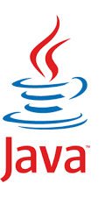




Language Adjectives/Terms:
Declarative
Structured Programming
Fluent API
Lazy Evaluation
Lambda
Imperative Programming
Object Oriented
cat
awk
grep
Functional Programming
Notes:
Going down the right side column:
Declarative, SQL
Declarative languages express the logic of a computation without describing its control flow in detail. Declarative programming stands in contrast to imperative programming via imperative programming languages, where control flow is specified by serial orders (imperatives).
Structured, at least Python
Structured programming is a programming paradigm aimed at improving the clarity, quality, and development time of a computer program by making extensive use of the structured control flow constructs of selection (if/then/else) and repetition (while and for), block structures, and subroutines in contrast to using simple tests and jumps such as the go to statement, which can lead to "spaghetti code" that is potentially difficult to follow and maintain.
Fluent API, Spark .. others possibly, but the inclusion of the word API makes Scala the best choice. Also Gremlin.
Lazy evaluation, Scala qualifies, and Spark is specifically the answer we most sought
Lambda, anonymous functions, and/or unnamed inline functions, JavaScript, Scala. There is also lambda architecture; not related, not discussed here.
Imperative programming, Java is specifically the answer we sought, also Python
In computer science, imperative programming is a programming paradigm that uses statements that change a program's state. In much the same way that the imperative mood in natural languages expresses commands, an imperative program consists of commands for the computer to perform. Imperative programming focuses on describing how a program operates.
Object oriented, Java, Scala, Python (yes, Python)
Object-oriented programming (OOP) is a programming paradigm based on the concept of "objects", which may contain data, in the form of fields, often known as attributes; and code, in the form of procedures, often known as methods. A feature of objects is that an object's procedures can access and often modify the data fields of the object with which they are associated (objects have a notion of "this" or "self"). In OOP, computer programs are designed by making them out of objects that interact with one another.[1][2] There is significant diversity of OOP languages, but the most popular ones are class-based, meaning that objects are instances of classes, which typically also determine their type.
Like Java, Scala is object-oriented, and uses a curly-brace syntax reminiscent of the C programming language. Unlike Java, Scala has many features of functional programming languages like Scheme, Standard ML and Haskell, including currying, type inference, immutability, lazy evaluation, and pattern matching.
Functional programming, Scala, Linux pipes
In computer science, functional programming is a programming paradigm—a style of building the structure and elements of computer programs—that treats computation as the evaluation of mathematical functions and avoids changing-state and mutable data. It is a declarative programming paradigm, which means programming is done with expressions or declarations[1] instead of statements. In functional code, the output value of a function depends only on the arguments that are passed to the function, so calling a function f twice with the same value for an argument x produces the same result f(x) each time; this is in contrast to procedures depending on a local or global state, which may produce different results at different times when called with the same arguments but a different program state. Eliminating side effects, i.e., changes in state that do not depend on the function inputs, can make it much easier to understand and predict the behavior of a program, which is one of the key motivations for the development of functional programming.
Reference Urls:
https://en.wikipedia.org/wiki/List_of_programming_languages_by_type
https://en.wikipedia.org/wiki/Structured_programming
https://en.wikipedia.org/wiki/Object-oriented_programming
https://en.wikipedia.org/wiki/Functional_programming

Slide 5
In Many Languages ..
Function Body (or Block), if not named, it is an anonymous function, or lambda
{ }
( )
Parameters to Function
Notes:
Match the attributes on the right with the areas on the left-

Slide 6
End of Discussion Lab:
Notes:
End of Discussion Lab-

Slide 7
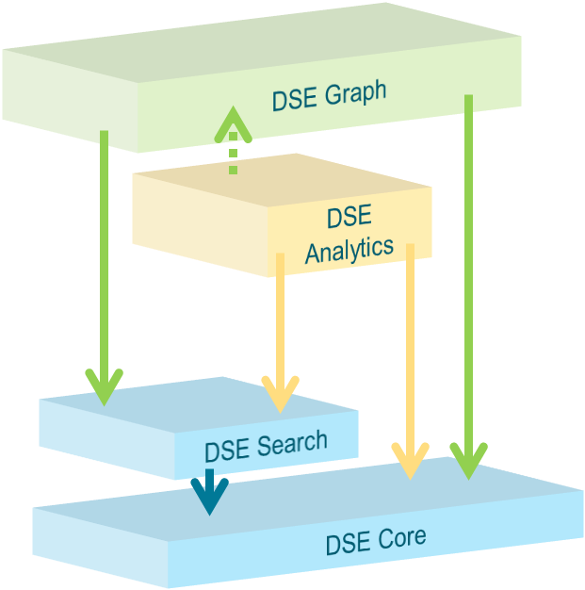

The 4 Primary Functional Areas to DSE
All 4 primary functional areas provide query processing
DSE Analytics
-- Parallel Query Processing
Horizontal scaling
High Speed
-- Batch, Streaming,
Iterative
Interactive
The Why
Query processing
Index and query processing
Notes:
The four primary functional areas to DSE are listed in the graphic above: DSE Core (Core), DSE Search (Search), DSE Analytics (Analytics), DSE Graph (Graph).
Core is always on; it is impossible to operate any node within a DSE cluster without Core.
The remaining 3 primary functional areas are either on or not on (on/booted/available, or not). If Search and a Search index is available (and necessary), Analytics or Graph may use said index. Generally, if Analytics or Graph would benefit from a Search index, and none is available, the Analytics or Graph routine will still function, albeit more slowly.
While Core is always on, (Search, Analytics and/or Graph) must be on/booted/available on a data center wide basis. That is to say: you should not boot (Search, Analytics, Graph) on a subset of nodes to a data center.
--
We discuss the capabilities of DSE Analytics on the pages that follow.

Slide 8
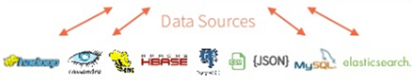
DSE Analytics: 5 Major Functional Areas
DataFrames
ML Pipelines
Spark SQL
Mllib/ML
GraphX
Spark Streaming
Spark Core
Notes:
There is the main Spark engine (core), and on top of it fits Spark’s 4 main modules: 4 + 1 == 5
(Some diagrams will also highlight a 5'th main module, Spark/R.)
Spark SQL and Data Frames
Gives SQL like access to data, many ANSI standards implemented
Can access Hive, Avro, Parquet, ORC, JSON, and JDBC
Allows you to join across the various data sources
No ETL needed to process data
Spark Streaming
Often used with Kafka
Native APIs for Java, Scala and Python
MLlib (machine learning)
Machine Learning and all the goodness
that implies
GraphX with GraphFrames
DSE graph ties into GraphFrames
May optimize certain type of DSE Graph
Jobs
Reference Urls,
https://mapr.com/blog/5-minute-guide-understanding-significance-apache-spark/

Slide 9
DSE Analytics: What is it-
Enhanced version of Apache Spark
DSE manages Spark Master and auto restarts without any other third party software
-- Restart of a Master with information on who is Master to whole cluster
-- Restart of any failed workers
Ability to submit jobs to any Spark nodes, rather than having to know who the master is
With DSE to Cassandra the data sits on the nodes with Spark, less data shuffling
-- Spark attempts to optimize jobs to pull data on local node primarily
-- In DSE 5.1 and above, both the Master and Worker run in the same JVM as DSE
-- Able to inherit unified DSE security features
DSE drivers to Cassandra
-- Continuous paging for speed in returning data
-- Integrate DSE Graph with Spark GraphFrames
-- Integration with DSE Search
Always on SQL Server replacing the non fault tolerant Thrift Server
Notes:
A series of (n) pages outlining the differences of DSE Analytics, as an integration of Apache spark with DSE; this isn't a connector like many vendors have, this is an integration.
By co-locating DSE Core and (Apache Spark), data is co-located. You do not have to lift and shift data from the operational system to the analytics system.
Both systems share the same security settings and configuration.
As a multi-model database layer, DSE offers (Apache Spark) integrated (Apache Solr) indexes, and Apache TinkerPop graph traversals.

Slide 10
DSE Analytics: What is it-
Integrated Platform for Advanced Analytics
An end-to-end, integrated platform; Spark has no persistent data tier
-- One-stop-shop for data ingestion, transformation and analytics (SparkSQL, MLlib, ML) via Spark integration
Workload isolation - No data movement between OLTP and OLAP systems
Transactional data immediately available for analysis
Drill down from analysis to current transactional data
Reduce the need for multiple copies of same data
Notes:
A series of (n) pages outlining the differences of DSE Analytics, as an integration of Apache spark with DSE; this isn't a connector like many vendors have, this is an integration.
Without having to copy the data from operational to analytics tiers, changes to operational data are immediately available for analysis; time to value.
As such, this reduces the need to have multiple copies of the data; less complex, hardware and infrastructure savings, other.

Slide 11
DSE Analytics: What is it-
Integrated Platform for Operational Analytics
Integrated with DSE
-- Masterless, distributed architecture
-- Multi-Data Center support
-- Multi-model platform
Inherits all the enterprise-class benefits of DSE:
-- Contextual insights (with Graph capability)
-- Always-on
-- Massively scalable
-- High-performance
-- Ease to use and manage, one less cluster
Notes:
A series of (n) pages outlining the differences of DSE Analytics, as an integration of Apache spark with DSE; this isn't a connector like many vendors have, this is an integration.
As listed, but also; it's just one less cluster to have to manage.

Slide 12
DSE Analytics: Key Use Cases
DataStax customers use DSE Analytics in the following areas:
Data Ingestion from streaming sources, with/without transformation/aggregation
Data Quality – primarily with respect to data ingestion
ETL – from one internal store to another and from external sources to internal stores
Pre-calculated Aggregates – scheduled “mini-batch”
Machine Learning on Operational Data
Real-time personalization & recommendation
Business Intelligence – via ODBC/JDBC connectivity
Primarily Tableau, working on partnering with additional BI vendors
Notes:
Key customer use cases include:
ETL/ELT, data ingestion
Parallel data manipulation
Machine learning
Other

Slide 13
Objections: Why use OSS Apache Spark
Different number of Spark nodes than Cassandra nodes
-- In DSE, collocated Spark/Cassandra nodes means 1:1 sizing
-- DSE 5.1+ supports “Spark-only DCs” and “Spark-only Clusters”
Separate Spark and Cassandra processing to avoid resource contention
-- While Spark can be somewhat controlled, Cassandra is less well behaved
-- The sacrifice is that reads are remote
Newer version of Spark than is in DSE
-- Largely this is spurious. Most customers can’t point to new feature they need (but some really can)
-- That said, Spark does not keep bug-fixing old releases
-- There has not been a Spark release past X.Y.2 (e.g., there was no 2.0.3)
-- Spark has performance optimizations to their core in new releases
-- The Catalyst optimizer has been a focus and will continue to be
Separate/existing customer team for Spark
Notes:
Potential customers objections over running open source Spark:
Spark-only DCs:
We have a way in DSE 5.1 to have a Spark-only DC which is part of the same C* cluster, but no C* data is pointed at it (via NetworkTopologyStrategy settings) but Spark Master/Workers are running - they read from the _other_ DC
Resource Contention:
Reasonable objection
Remote reads: the network is not the bottleneck, so a network hop may be fine
Newer version of Spark.
Most folks claim needing access to the “latest and greatest”, but we are targeting an “Enterprise” audience
New Release = Stability (plus some instability of new features/APIs, etc - it’s a tradeoff)
Reference Urls,
https://docs.datastax.com/en/dse/5.1/dse-admin/datastax_enterprise/analytics/aboutDseAnalyticsSolo.html

Slide 14
DSE Analytics (Apache Spark):
DSE Analytics process architecture
User Interfaces
[ The ] Primary Spark API; RDDs, DataFrames, Dataset
Operational Details
Notes:
Now migrating the conversation to a number of the operational details of DSE Analytics; process architecture, other

Slide 15
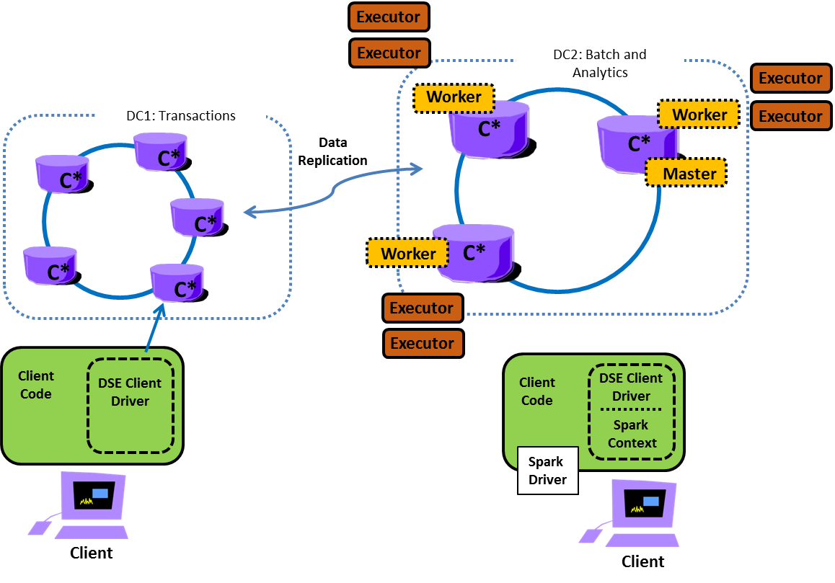
DSE Analytics: Process Architecture
Notes:
On the diagram above:
Two DSE data centers are pictured; one configured for transactions (DSE Core), the second configured for analytics (DSE Analytics).
The descriptions that follow address a client application running an analytics routine, accessing the DSE Analytics data center.
The client application exists as a separate process; if the client is Java based, the client exists as a separate JVM. The client process (the JVM) begins and ends, as the client application begins and ends. The client application has a main().
The client application instantiates a program object titled, SparkContext, which provides access to the (DSE Analytics data center, aka, Spark cluster). As a result of this action, the client program is identified as the (Spark) driver.
Reference Urls,
https://www.dezyre.com/article/apache-spark-architecture-explained-in-detail/338
https://stackoverflow.com/questions/42263270/what-is-the-concept-of-application-job-stage-and-task-in-spark

Slide 16
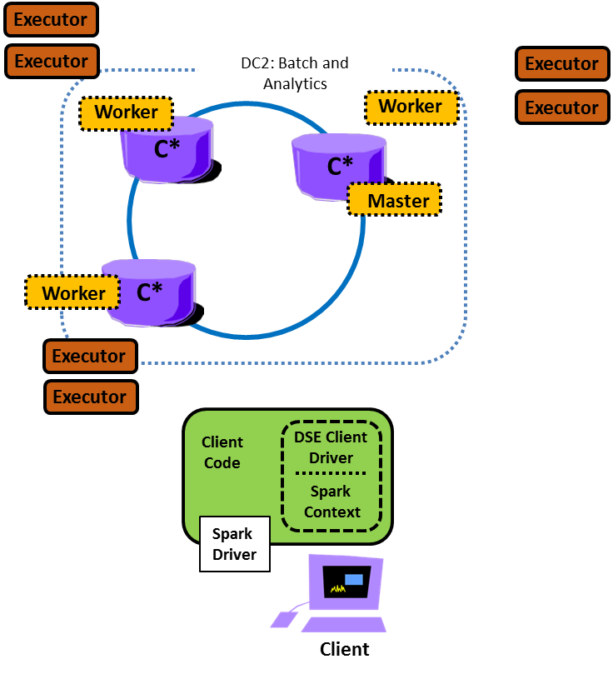
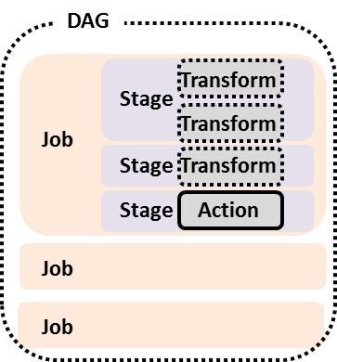
DSE Analytics: Process Architecture
4
1:M
Task/Partition
5
3
2
...
1
Notes:
On the diagram above:
Generally, expect that the client application accesses at least one data source, followed by zero or more transformations. Through lazy evaluation, no actual work (job) is performed on the DSE analytics data center (Spark cluster) until a transformation leads to an action. (The initial data source access is itself a transformation.)
The driver converts the client application code containing transformations and actions into a logical, directed acyclic graph (DAG). The event that creates a DAG, is an action. Creating a DAG is as runtime event. There is no compile-time DAG.
An action in the DAG has a one to one correspondence with a job.
As the action may have been proceeded by one or more transformations, a job has one or more stages.
A single stage may represent one or more transformations. Why ? Optimizations are performed by the driver as the driver converts the logical DAG into a physical execution plan with sets of stages. By example, a data source read followed directly by a filter (two transformations), may be combined into one stage.
A stage is a logical unit of work. A stage represents a subset of the DAG; some number of transformations followed by an action.
DSE Analytics (Apache Spark) is an in-memory parallel data analytics engine.
Generally, expect that the original data source accessed by a job (a DSE table ?) was balanced across several DSE nodes, further organized into distinct DSE table partitions.
As such, a stage may need to access data on (n) DSE nodes, further organized into (m) DSE table partitions.
As such, the logical term stage (a logical unit of work), makes use of multiple physical entities titled, tasks. There is a one to one relationship between a task and a partition involved in a given stage.
DSE Analytics (Apache Spark) is an in-memory parallel data analytics engine.
As such, stages will continue to make use of multiple tasks after data has been lifted from disk, and before data needs to return to disk, or be returned to the client application.
Stages making use of tasks (threads on a JVM), allows for parallel, presumably faster execution of jobs and applications.
"There is a one to one relationship between a task and a partition"; in memory, the data being processing is organized into partitions just like DSE table data on disk, and for the same reasons.
The driver submits the DAG to the DSE Analytics master node. (A DSE analytics application can be run from any DSE Analytics node; the DSE driver will automatically route this request to the master node.) There is one DSE Analytics master node per DSE cluster.
While DSE offers a masterless architecture, (Apache Spark) is a master/slave architecture.
When a DSE cluster containing data centers configured to support DSE Analytics comes online, an election designates one node as the master. Should the master fail, another node is automatically elected to become master.
The master exists as a thread in the JVM operated by the DSE node proper.
If configured to operated as a DSE analytics node, the master is always on, always present, and never terminates.
Upon submission of a job by the driver, the master tells the workers on each node to instantiate a number of executors, based on the amount of requested resource; CPU and RAM (JVM heap).
Workers exist as a thread on each node, in each JVM operated by the DSE nodes proper. Workers never terminate.
Executors exists as JVMs outside of any DSE JVM. Executors terminate when their work is complete.
The master assigns executors to a job.
The master tracks which workers, and executors are up or down, what jobs are running, other.
The worker (local to each DSE node) launches executors local to any DSE node as directed by the master.
The worker tells the master what executors are running.
There is normally one worker per DSE node, but outlying/edge cases may apply.
The executor is assigned its own amount of memory and cores by the worker
The executor communicates with the driver; the driver assigns tasks to the executor. (The driver owns and manages the DAG.)
The executor retrieve JARs, code, work from the driver directly.
The executor is the only real worker; reading and writing from DSE, other, and performing the transformations and actions as specified by the DAG.
the executor performs work on behalf of one task at a time.
The executor sends results to the driver.
The executor also sends a heartbeat, progress information to the driver.
Generally, the executor exists for the entire lifetime of the application (the driver), and is terminated with same. However, drivers can also opt for dynamic allocations of executors wherein they can add or remove spark executors dynamically to match with the overall workload.
Reference Urls,
https://www.dezyre.com/article/apache-spark-architecture-explained-in-detail/338
https://stackoverflow.com/questions/42263270/what-is-the-concept-of-application-job-stage-and-task-in-spark

Slide 17
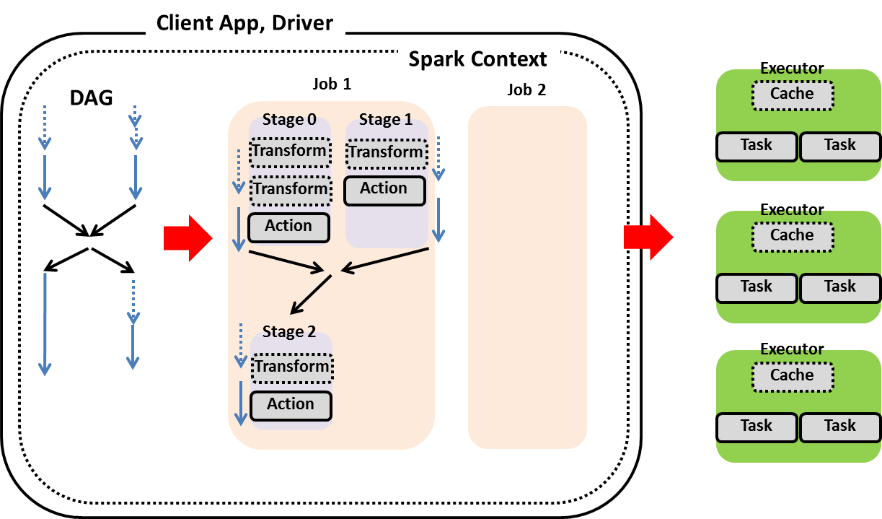
DSE Analytics: Process Architecture
Notes:
On the diagram above:
Generally, expect that the client application accesses at least one data source, followed by zero or more transformations. Through lazy evaluation, no actual work (job) is performed on the DSE analytics data center (Spark cluster) until a transformation leads to an action. (The initial data source access is itself a transformation.)
The driver converts the client application code containing transformations and actions into a logical, directed acyclic graph (DAG).
An action in the DAG has a one to one correspondence with a job.
As the action may have been proceeded by one or more transformations, a job has one or more stages.
A single stage may represent one or more transformations. Why ? Optimizations are performed by the driver as the driver converts the logical DAG into a physical execution plan with sets of stages. By example, a data source read followed directly by a filter (two transformations), may be combined into one stage.
A stage is a logical unit of work. A stage represents a subset of the DAG; some number of transformations followed by an action.
DSE Analytics (Apache Spark) is an in-memory parallel data analytics engine.
Generally, expect that the original data source accessed by a job (a DSE table ?) was balanced across several DSE nodes, further organized into distinct DSE table partitions.
As such, a stage may need to access data on (n) DSE nodes, further organized into (m) DSE table partitions.
As such, the logical term stage (a logical unit of work), makes use of multiple physical entities titled, tasks. There is a one to one relationship between a task and a partition involved in a given stage.
DSE Analytics (Apache Spark) is an in-memory parallel data analytics engine.
As such, stages will continue to make use of multiple tasks after data has been lifted from disk, and before data needs to return to disk, or be returned to the client application.
Stages making use of tasks (threads on a JVM), allows for parallel, presumably faster execution of jobs and applications.
"There is a one to one relationship between a task and a partition"; in memory, the data being processing is organized into partitions just like DSE table data on disk, and for the same reasons.
The driver submits the DAG to the DSE Analytics master node. (A DSE analytics application can be run from any DSE Analytics node; the DSE driver will automatically route this request to the master node.) There is one DSE Analytics master node per DSE cluster.
While DSE offers a masterless architecture, (Apache Spark) is a master/slave architecture.
When a DSE cluster containing data centers configured to support DSE Analytics comes online, an election designates one node as the master. Should the master fail, another node is automatically elected to become master.
The master exists as a thread in the JVM operated by the DSE node proper.
If configured to operated as a DSE analytics node, the master is always on, always present, and never terminates.
Upon submission of a job by the driver, the master tells the workers on each node to instantiate a number of executors, based on the amount of requested resource; CPU and RAM (JVM heap).
Workers exist as a thread on each node, in each JVM operated by the DSE nodes proper. Workers never terminate.
Executors exists as JVMs outside of any DSE JVM. Executors terminate when their work is complete.
The master assigns executors to a job.
The master tracks which workers, and executors are up or down, what jobs are running, other.
The worker (local to each DSE node) launches executors local to any DSE node as directed by the master.
The worker tells the master what executors are running.
There is normally one worker per DSE node, but outlying/edge cases may apply.
The executor is assigned its own amount of memory and cores by the worker
The executor communicates with the driver; the driver assigns tasks to the executor. (The driver owns and manages the DAG.)
The executor retrieve JARs, code, work from the driver directly.
The executor is the only real worker; reading and writing from DSE, other, and performing the transformations and actions as specified by the DAG.
the executor performs work on behalf of one task at a time.
The executor sends results to the driver.
The executor also sends a heartbeat, progress information to the driver.
Generally, the executor exists for the entire lifetime of the application (the driver), and is terminated with same. However, drivers can also opt for dynamic allocations of executors wherein they can add or remove spark executors dynamically to match with the overall workload.
Reference Urls,
https://www.dezyre.com/article/apache-spark-architecture-explained-in-detail/338
https://stackoverflow.com/questions/42263270/what-is-the-concept-of-application-job-stage-and-task-in-spark

Slide 18
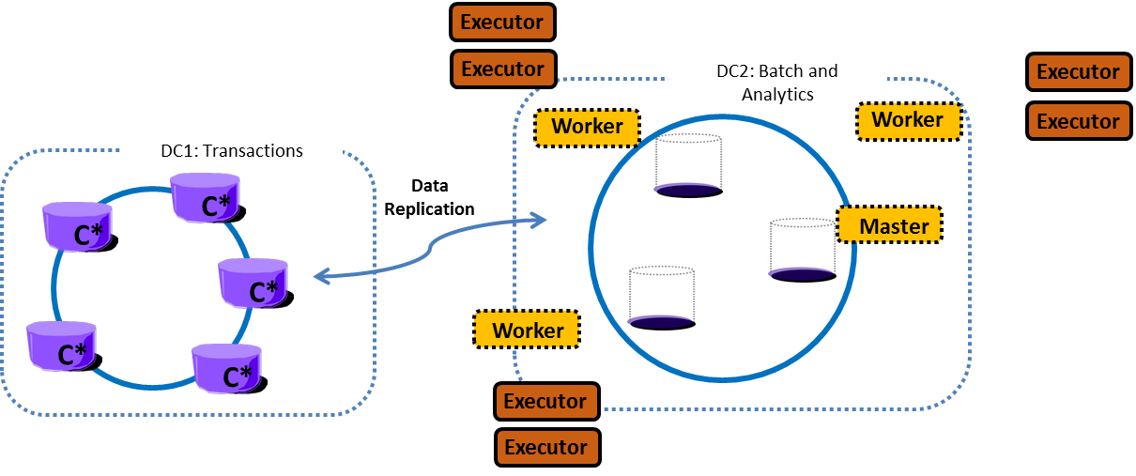
DSE Analytics: Process Architecture, (Outlier topics)
DSE Analytics Streaming; one executor only, always on (?)
Driver can be hosted locally or remote
DSE 5.1+, can have analytics only nodes; no local data
For executors, data must be available via same path on every node; DSEFS
Notes:
The topics above are offered at a high level only for now.
Reference Urls,
https://jaceklaskowski.gitbooks.io/mastering-apache-spark/content/spark-dagscheduler.html
https://www.datastax.com/2018/02/introducing-dse-analytics-solo

Slide 19
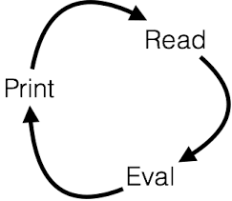
DSE Analytics: UIs
dse spark
:quit
dse spark-sql
quit;
dse pyspark
quit()
dse sparkR
(Will fail without R)
dse spark-submit xxx.jar
http:// (master node) :7080
http:// (driver host) :4040 41, 42
(Other)
Java, Scala, Python, R
will automatically find Spark Master
Notes:
User interfaces to the DSE Analytics system:
The first three are REPLS; evaluation loops
The first REPL is the Scala REPL, pre-configured for DSE Analytics (Apache Spark)
The spark-submit is the means by which we submit a true application; JVM, Python, other
The two Urls listed lead to the Spark Master, and any application that is running. The 4040 port number is assigned to the first application, 4041 the second, and so on. If no application is running, then this port will not respond.
Reference Urls,
https://en.wikipedia.org/wiki/Read%E2%80%93eval%E2%80%93print_loop

Slide 20
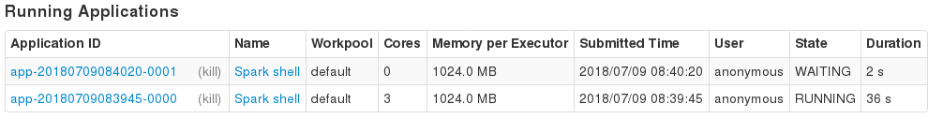
DSE Analytics: Resource Math
On the server; dse.yaml, spark-env.sh, other
Tiered, many, non-trivial
RAM, Cores, other
See Url
On the client; in code, or ENV
Subject to server limits
RAM, Cores, other
See Url
Notes:
The DSE Analytics system is configured to provide a given amount of resource. Applications can call to consume resource from this available set.
By default, the DSE Spark shell (dse spark, Scala REPL), will call to consume all available cores. As such, any second and subsequent DSE Spark shell will appear to be hung, as no cores are available.
Screen shot from the Spark Master Web UI.
Reference Urls,
Server side, https://docs.datastax.com/en/dse/6.0/dse-dev/datastax_enterprise/spark/sparkConfiguration.html
Client side, https://docs.datastax.com/en/dse/6.0/dse-dev/datastax_enterprise/spark/sparkCassandraProperties.html

Slide 21
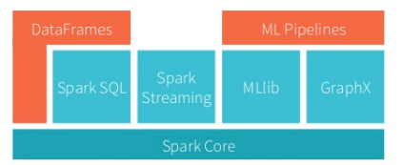
DSE Analytics: Programming Model
Structured
Streaming
Advanced
Analytics
Libraries
& Ecosystem
Structured APIs
Datasets
SQL
DataFrames
Low Level APIs
Image Source: DataBricks.com
RDDs
Distributed Variables
Source: https://www.amazon.com/Spark-Definitive-Guide-Processing-Simple/dp/1491912219
Notes:
Comments relative to the slide above:
Earlier we used the diagram on the left, sourced from DataBricks. The left side diagram is accurate, for the information it represents.
The right side diagram is sourced from the O'Reilly book, Spark: The Definitive Guide.
What we like about the right side diagram is how it differentiates RDDs, from Datasets and DataFrames. While these three objects appear to be extensions from one another (RDDs -> DataFrames -> Datasets), it bears noting that RDDs are a lower level object, with different supported methods and behaviors.
Net/net, you can not take a DAG that sourced from an RDD, and just cast the RDD into a DataFrame, and expect to have all methods supported.
RDDs have use cases, as do DataFrames, and Datasets, and we discuss each on the pages that follow.

Slide 22
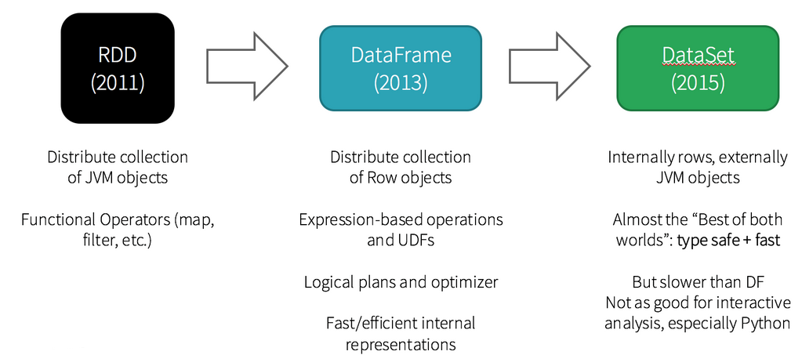
DSE Analytics: Programming Model
Image Source: DataBricks.com
Notes:
Comments relative to the slide above:
A bit more on the topic of the differences between RDDs, and DataFrames and Datasets.
By their nature, Datasets use native Java objects (allowing strong compile time checking). With the JVM requirement, Datasets are not available on non-strongly typed variable platforms like Python.
DataFrames are available on all Spark supported platforms.
DataFrames differ from RDDs in that RDDs are opaque to the Spark runtime. In effect, an RDD is a collection (array) of integers, strings, records, other. A DataFrame is similar to an RDD, but also provides metadata to the Spark runtime; column names, other.
As such, DataFrames offer superior performance. A optimizer titled, Catalyst, inside the Spark runtime has the opportunity to re-sequence, or merge transformations using DataFrames for greater efficiency. For example, a (read) -> sort -> filter using a DataFrame, can be automatically rewritten as (read) -> filter -> sort, to reduce overall workload.
More on this topic later when we discuss DataFrames, and explain plans. (Explain plans; similar to a relational database explain plan.)

Slide 23
DSE Analytics (Apache Spark):
What is Functional Programming (FP), and Why You Care
Functional Programming
Notes:
Now migrating the conversation to the topic of Functional Programming.

Slide 24
Scala: What does this fragment output ?
val names = List("Bob", "Nancy", "Dirk")
def myUC(Args: List[String]) : List[String] = {
var myList: List[String] = List()
//
for (s <- Args) {
myList = s.toUpperCase :: myList
}
myList
}
val capNames = myUC(names)
capNames.foreach(println)
Notes:
What does the code fragment above output ?
More:
The above is written in the imperative programming style; tell the (computer) what to do.

Slide 25
Scala: What do these fragments output ?
val names = List("Bob", "Nancy", "Dirk")
val capNames = for (e <- names) yield e.toUpperCase
capNames.foreach(println)
val capNames = names.map(_.toUpperCase)
capNames.foreach(println)
val nums = List(1, 2, 3)
val nums2 = nums.map(_ * 2)
nums2.foreach(println)
Notes:
What does the code fragment above output ?
More:
Each of the first and second blocks output the same as the block on the previous page.
The second block is how Spark, and certainly Scala programmers will write their Spark transforms. This block is written using functional programming (FP).
If you don't master this programming style, it will greatly inhibit your skills adoption and abilities.
The last code block is the same as the second on this page; just another example to confirm comprehension.

Slide 26

Definition of: map()
Factor out common patterns
Iterate over List elements
Term comes from the mathematics domain
Things that can be mapped over are called functors
Methods of Scala's collections classes: drop(), filter(), map(), reduce()
Notes:
Defining the term map.

Slide 27
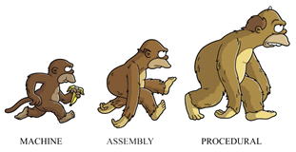
Functional Programming (FP): Why Do You Care ?
98% of the examples you seek to use from books and on Google, will be FP (you need to be able to read)
Knowing FP required to move from beginner to beyond beginner
The best way to write parallel and concurrent applications; thread safe, no sync issues
...
Source: https://medium.com/@cscalfani/so-you-want-to-be-a-functional-programmer-part-1-1f15e387e536
Notes:
Understanding functional programming is important because:
Spark expects a transform that is written using FP
[ All ] of the examples you see will be written using FP
Even when not using Spark, FP has many advantages

Slide 28

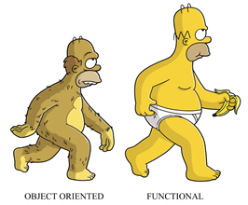
Functional Programming (FP): Why Do You Care ?
FP Language Features-
Immutable data, first class functions, tail call optimization
FP Programming Techniques-
Mapping, reducing, pipelining, recursing, currying, higher order functions (HOF)
FP Advantages-
Easier to parallelize, lazy evaluation, easier to test, determinism
...
Which entity in the Spark RT is pipelining ?
PF == ODI + NSE
Output
Depends
on Input
Pure
Functions
No Side
Effects
Source: https://medium.com/@cscalfani/so-you-want-to-be-a-functional-programmer-part-1-1f15e387e536
FP is the opposite of imperative programming
Notes:
Understanding functional programming is important because:
Spark DAGs, and the primary API objects (RDDs, DataFrames, Datasets), follow an immutable data flow diagram.
Spark deals with collections, arrays. Pure functions (Functional Programming), naturally want to recurse as they iterate over lists.

Slide 29


DSE Analytics: Intermediate and above level
Functional
Programming
FP, and imperative programming styles
FP for transforms, imperative for UI
What Spark is written in; examples, other
Immutability, thread safe, concurrency, out of the box
Rich Java package library
Notes:
Comments relative to the above:
Learning Spark almost causes you to learn 3 major things at one time; functional programming, Scala, and then Spark.

Slide 30
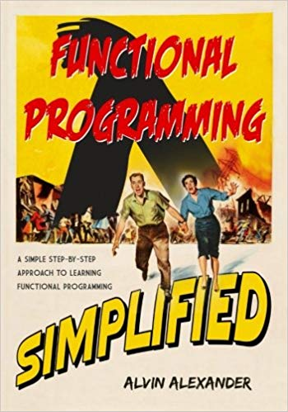
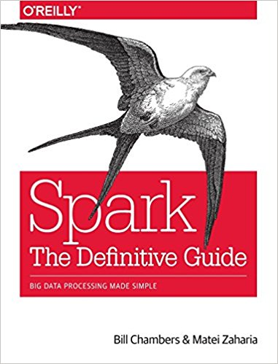
DSE Analytics: Must Reads ?
Notes:
The functional programming book is available at,
https://www.amazon.com/gp/product/1979788782
with a 400 page free preview at,
https://alvinalexander.com/scala/functional-programming-simplified-book
The Spark book is available at,
https://www.amazon.com/Spark-Definitive-Guide-Processing-Simple/dp/1491912219

Slide 31
End of Unit:
Notes:
End of Discussion Unit-

Slide 32
Additional Detail:
Notes:
The remaining content may be read “extra credit”, as time allows.

Slide 33
History of Apache Spark
A Brief History of Spark-
Spark was initially started by Matei Zaharia at UC Berkeley's AMPLab in 2009, and open sourced in 2010 under a BSD license.
In 2013, the project was donated to the Apache Software Foundation and switched its license to Apache 2.0. In February 2014, Spark became a Top-Level Apache Project.
In November 2014, Spark founder M. Zaharia's company Databricks set a new world record in large scale sorting using Spark.
Spark had in excess of 1000 contributors in 2015, making it one of the most active projects in the Apache Software Foundation and one of the most active open source big data projects.
Notes:
Reference Urls,
https://en.wikipedia.org/wiki/Apache_Spark#History

Slide 34
History of Apache Spark
Spark was originally developed to address the limitations of MapReduce.
It is a distributed computing system, utilizing many machines to do a job
While MapReduce reduces and writes to disk, Spark was developed as a shared memory system
-- Most work and data being held in memory
-- Spilled over to disk if memory capacity is met
Because of this Spark is touted as being orders of magnitude faster than MapReduce
Major speed enhancements came out it
-- 1.6 with solidifying DataFrames
-- 2.0 with solidifying DataSets and Tungsten execution backend
-- 2.2 Structured Streaming
Easier to program and code
Can do analytics in real time as well as batch
-- MapReduce is not a real time analytics engine
Notes:
Reference Urls,
https://en.wikipedia.org/wiki/Apache_Spark#History

Slide 35
Spark is New, Fast Moving
Young and a very active open source project
It has moved fast in the last couple of years
Version changes coming very quickly
Major API changes
It is anticipated that like many open source projects this will slow down and the API will start becoming more stable
But for now still very inventive
This implies DSE may lag a few releases behind
-- 5.1.x DSE comes with Spark 2.0.x
-- 2.1.0 of Spark was already released when 5.1.0 was released
-- 6.0.0 released with the latest, Spark 2.2.x
Notes:
Activity of Spark as an Apache project.

Slide 36
Spark Cluster Managers:
Spark Standalone
The Spark Standalone cluster manager is a simple cluster manager available as part of the Spark distribution. It has HA for the master, is resilient to worker failures, has capabilities for managing resources per application, and can run alongside of an existing Hadoop deployment and access HDFS (Hadoop Distributed File System) data. The distribution includes scripts to make it easy to deploy either locally or in the cloud on Amazon EC2. It can run on Linux, Windows, or Mac OSX.
Apache Mesos
Apache Mesos, a distributed systems kernel, has HA for masters and slaves, can manage resources per application, and has support for Docker containers. It can run Spark jobs, Hadoop MapReduce, or any other service application. It has API’s for Java, Python, and C++. It can run on Linux or Mac OSX.
Hadoop YARN
Hadoop YARN, a distributed computing framework for job scheduling and cluster resource management, has HA for masters and slaves, support for Docker containers in non-secure mode, Linux and Windows container executors in secure mode, and a pluggable scheduler. It can run on Linux and Windows.
Or, Datastax Analytics
Source: http://www.agildata.com/apache-spark-cluster-managers-yarn-mesos-or-standalone/
Notes:
Reference Urls,
http://www.agildata.com/apache-spark-cluster-managers-yarn-mesos-or-standalone/

Slide 37
Useful Links:
https://spark.apache.org/
http://spark.apache.org/docs/2.0.2/programming-guide.html
http://spark.apache.org/docs/2.0.2/configuration.html
https://spark.apache.org/docs/latest/structured-streaming-programming-guide.html (not quite there for DSE 5.1)
https://github.com/datastax/spark-cassandra-connector/tree/master/doc
https://www.youtube.com/watch?v=cKIHRD6kUOc&index=40&list=PLm-EPIkBI3YoiA-02vufoEj4CgYvIQgIk (Russ!)
https://support.datastax.com/hc/en-us/articles/204939759-Spark-shell-with-SSL-enabled-clusters
http://www.bigsynapse.com/controlling-the-number-of-partitions-in-spark
http://blog.cloudera.com/blog/2015/03/how-to-tune-your-apache-spark-jobs-part-1/
https://www.dezyre.com/article/top-10-machine-learning-algorithms/202
http://c2fo.io/c2fo/spark/aws/emr/2016/07/06/apache-spark-config-cheatsheet/
http://www.sparktutorials.net/analyzing-flight-data:-a-gentle-introduction-to-graphx-in-spark
Notes:
A number of links used in the creation of this content.

Slide 38
Useful Links:
https://databricks.com/blog/2016/10/03/voice-from-cern-apache-spark-2-0-performance-improvements-investigated-with-flame-graphs.html
https://databricks.com/blog/2016/05/23/apache-spark-as-a-compiler-joining-a-billion-rows-per-second-on-a-laptop.html
https://www.gitbook.com/book/jaceklaskowski/mastering-apache-spark/details
https://www.analyticsvidhya.com/blog/2015/07/difference-machine-learning-statistical-modeling/
http://www.doanduyhai.com/blog/?p=2325 (Setting up Zeppelin)
https://databricks.com/blog/2017/10/19/introducing-natural-language-processing-library-apache-spark.html
https://databricks.com/blog/2017/08/31/cost-based-optimizer-in-apache-spark-2-2.html
http://www.stratio.com/blog/optimizing-spark-streaming-applications-apache-kafka/
https://techvidvan.com/tutorials/apache-spark-performance-tuning/
http://shop.oreilly.com/product/0636920046967.do (High Performance Spark Book)
https://www.gitbook.com/book/jaceklaskowski/mastering-apache-spark/details (Book)
Notes:
A number of links used in the creation of this content.

